Slide 1

X-FILES
PITCH DECK

Slide 2

YOUR INTEGRITY PARTNER

Slide 3
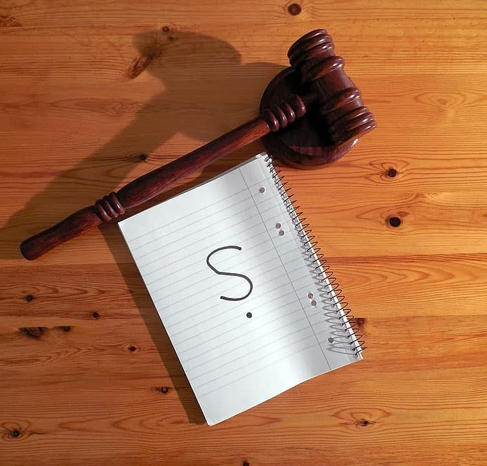
PROBLEM STATEMENT
Corruption is a rampant menace globally.
Corrupt officicals rarely face justice.
Massive alterations of evidences and bribery

Slide 4
SOLUTION
I-Reporter is a web-based application.
Focus is on building a community of trust.
Whistleblower anonymity.
Use oF smart contracts in soring evidence.
Progress tracking capabilities

Slide 5

TARGET CUSTOMERS
Whistleblowers
Anti-corruption commission offices
Courts
JJournalists

Slide 6
TOTAL MARKET SIZE
I- reporter can be used for different customer segments due to its robust nature.
It can be used in every government agency, judicial courts, private enterprises, schools, small businesses to mention just but a few
This accounts up to atl east 10 million users in Kenya alone where corruption cases are rampant in almost every institution.
The market size lso extends to Africa and the world beyond where countries have high corruption indices

Slide 7
COMPETITIVE ADVANTAGE
Ease of use
Scalability
Real time tracking
Assured integrity

Slide 8
ANTICIPATED IMPACT
Trust in judicial systems
Evidence Integrity
Legal action of guilty persons.
Reduced corruption cases.
Whistleblower protection.

Slide 9
BUSINESS MODEL
SMS based notification charges
Customization charges
Maintenance fees
Paid advertising on the websites

Slide 10
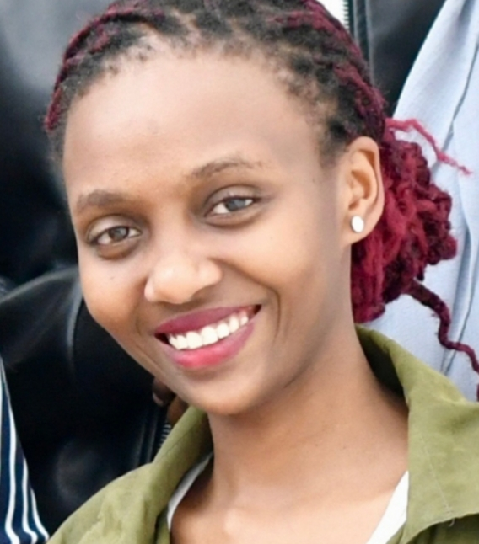
SHANNON MUJERA Shannon is an Informatics and Computer Science student at Strathmore university. She is seasoned leader having served as a student leader, youth ambassador for the UNDESA among other roles. She is a passionate innovator who believes in the power of technology changing lives. She is also skilled in entepreneurship and business development.

Slide 11
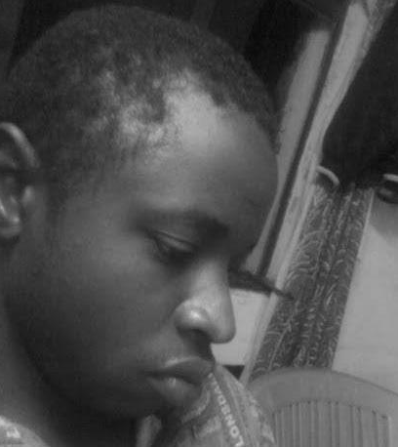
ARTHUR EARL Arthur Earl is a student at Moringa school. He is a full stack developer skilled in flask, Django , javascript among other web technologies. He is passionate about problem solving and loves to take on new challenges.

Slide 12

THANKYOU FOR CHOOSING I-REPORTER!

